Slide 1
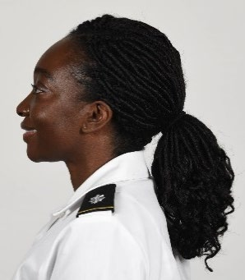
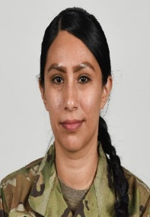
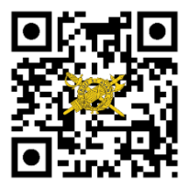
THE
Your Unit
Patch / Crest
Here.
IG UPDATE
Volume 21-1a, May 2021
Supplemental Guidance to IG Update 21-1: Updates to Appearance and Grooming Standards Policies
On April 30, 2021, the Acting Secretary of the Army released Memorandum, “Appearance and Grooming Policies for the United States Army,” which further modified the policies outlined in the February 24, 2021, guidance of the same title. This memorandum and the associated Deputy Chief of Staff, G–1, ALARACT 040-2021 (United States Army Appearance and Grooming Modifications), are the result of feedback from the force and the Army’s commitment to fostering an environment that promotes and facilitates diversity, equity, and inclusion. The upcoming revision of Chapter 3, Army Regulation (AR) 670-1 (Wear and Appearance of Army Uniforms and Insignia) will include the following modifications and those previously released.
Hairstyles and Length:
Female Soldiers can wear ponytails in all uniforms. Hair must be neatly and inconspicuously fastened and/or secured in a bun, singular ponytail, two braids, or singular braid. Multiple locs, braids, twists, or cornrows may come together in one or two braids or a single ponytail.
Length of braids and singular ponytails will not extend past the bottom of the shoulder blades when standing at attention. There is no minimum hair length for a ponytail or braid(s).
The only exceptions to the length of the ponytail or braid(s) are while conducting tactical or physical training in the ACU or APFU. The length of the secured hair cannot hinder a Soldier’s performance and or increase risk or safety.
No portion of the bulk of the hair, as measured from the scalp, will exceed 2 inches (except a bun, which is worn on the back of the head (centered) and may extend a maximum of 3 1/2 inches from the scalp and be no wider than the width of the head).
Hairstyles, cont.
In all uniforms, the unsecured hair will be worn centered in the back of the head (not on the side or top of the head); hair cannot be wider than the width of the head or interfere with proper wear of authorized Army headgear.
While female Soldiers are wearing equipment, (e.g., combat vehicle crewman or advanced combat helmet), they are authorized to wear their hair in a ponytail and or a long braid(s) secured in their utility uniform top.
Female Soldiers can also wear “multiple hairstyles” (e.g., braided twists or loc hair style with a side twist to secure hair placed in a ponytail, two single cornrows encompassing all hair going into a ponytail or bun).
Commanders will consider the risk of a free hanging ponytail or braid and use their discretion to determine if long hair will be tucked inside the uniform top.
*Please consider safety considerations such as ripping, tearing, pulling, or entanglement due to hair being caught on an object/obstacle if hair is not properly secured.
Lipstick: Female Soldiers can wear solid color shades of lipstick, to included tinted glosses. They may also wear lip liner, but the colors must match the shade of lipstick worn.
In addition to these modifications, the revision of AR 670-1 will include up-to-date images that reflect authorized and unauthorized hairstyles, nail shapes and color, lipstick colors, and earrings to assist leaders with clear and concise guidance.
Your Unit Name Here
Commanding General
MG Soldier Q. Public
Command Sergeant Major
CSM Soldier Q. Public
Command Inspector General
LTC Soldier Q. Public
Inspector General NCOIC
SGM Soldier Q. Public
IG Points of Contact
Unit IG Office
Building 1234
Hooah Drive
Fort Swampy LA 55555
Unit IG Website
http:\IG-bla-bla-bla.mil
Unit IG Office Email
IG-bla-bla@mail.mil
Unit IG Hotline
555-555-5555
Unit IG Office
555-555-5555
References SECARMY Memo (Appearance and Grooming Policies for the United States Army), 30 April 2021. *ALARACT 040-2021. AR 670-1 DA PAM 670-1 (Guide to the Wear and Appearance of Army Uniforms and Insignia), 26 January 2021. *replaces ALARACT 016/2021
ig.army.mil

